Slide 1
EE 74099 / EN 74099 Research Project
Progress Presentation For The Final Year Project
17.12.2019
Project title: Order Management System And Vision Based Autonomous Delivery Robot For Restaurants
Members:
ANFM. Begum, GSU. Ahmadh & IIS. Prema Sri
Supervised by : Dr. WGCW Kumara & Eng. MFM. Abdul Cader
Department of Electrical and Telecommunications Engineering
Faculty of Engineering
South Eastern University of Sri Lanka

Slide 2
CONTENT
CONTENT
Introduction
Objective
Methodology
Order Management System
Communication
Robot Design and Motion Control
Image Transmission, Processing and Path Planning
Future Works

Slide 3
INTRODUCTION
INTRODUCTION
Our project is mainly on having an external vision based navigation system for indoor robots.
As for the application of it, a restaurant delivery robot will be built and run on this system.

Slide 4
OBJECTIVE
OBJECTIVE
Having a navigation system for internal robots by directing it with an external vision based navigation system and applying the system for restaurant delivery robot

Slide 5
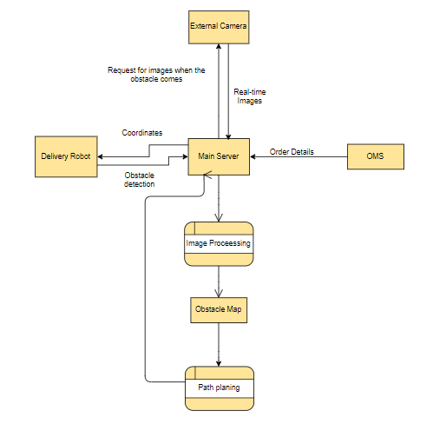
DATA FLOW DIAGRAM FOR SYSTEM

Slide 6
TIMELINE
TIMELINE
Order Management System
Jun 19 - Aug 19
Vision based obstacle detection and path planning
Aug 19 - Oct 19
Navigation of the robot
Oct 20 - Dec 31
Building the robot
Jun 24 - Sep 15
2019
06/19
07/17
08/14
09/11
10/09
11/06
12/04
2019
Today

Slide 7
ORDER MANAGEMENT SYSTEM

Slide 8
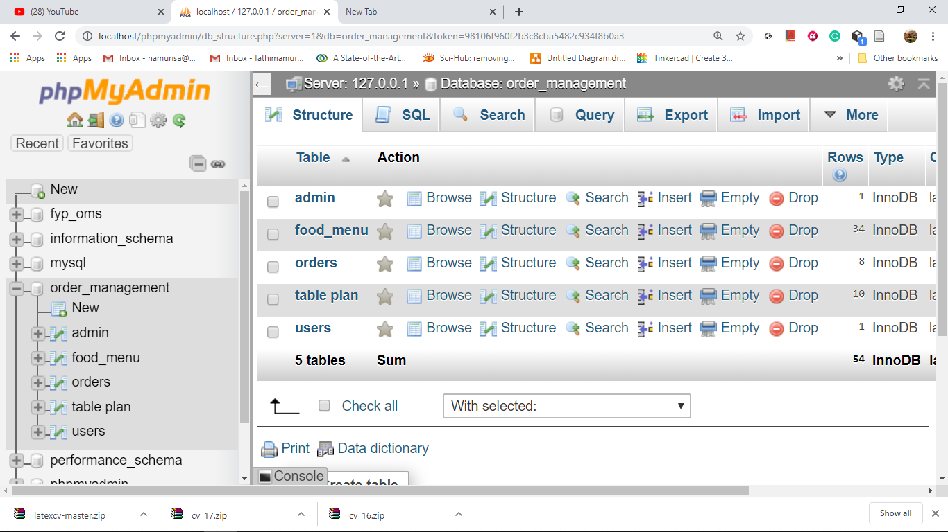
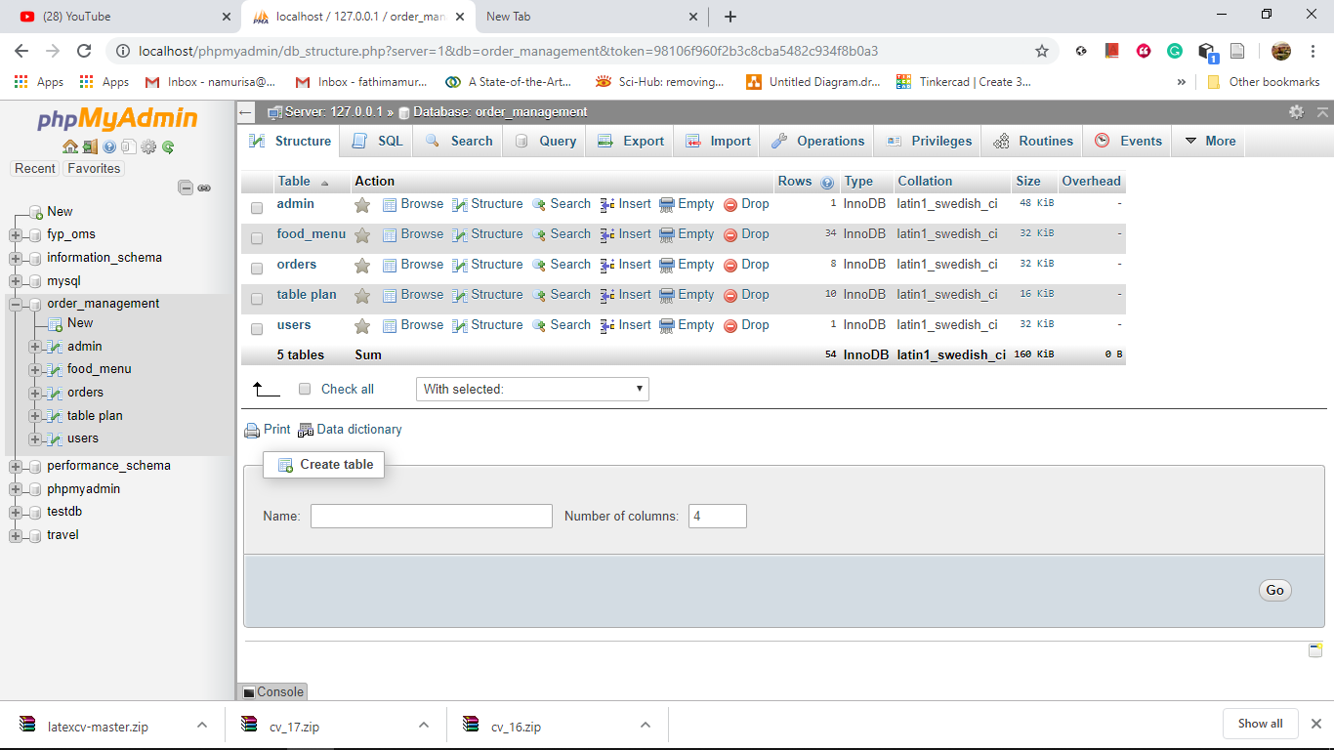
DATABASE
Database
Data base consists,
Credential Information
Food lists
Ordered items
Table allocation

Slide 9
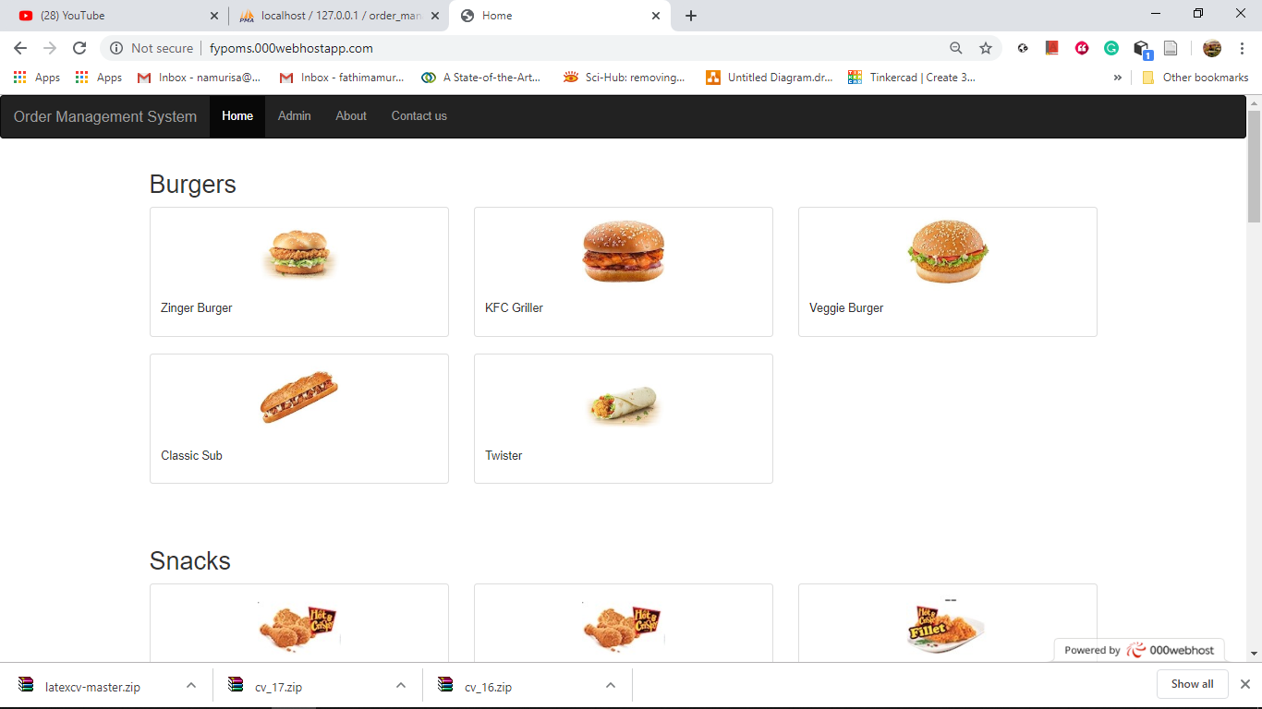
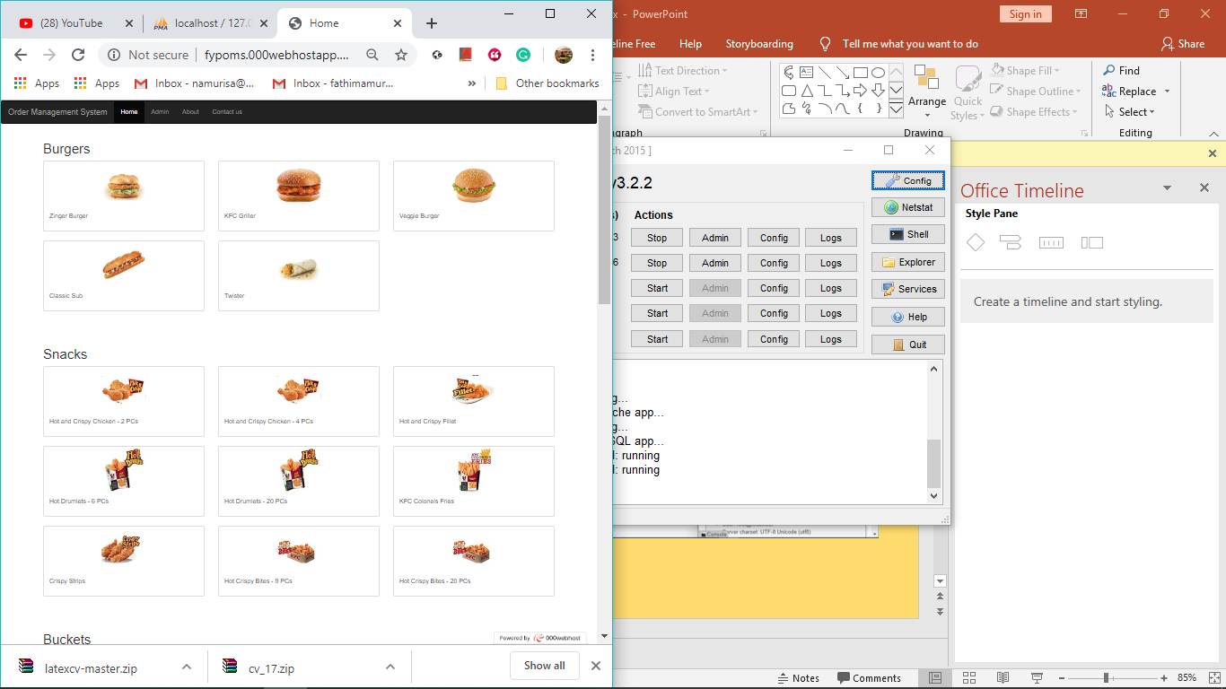
USER INTERFACE
User Interface
The UI of OMS is used to,
receive the order from webpage and update it in the database
create Interface for customer and admin
connect the database to the webpage and update the orders in admin page

Slide 10
COMMUNICATION

Slide 11
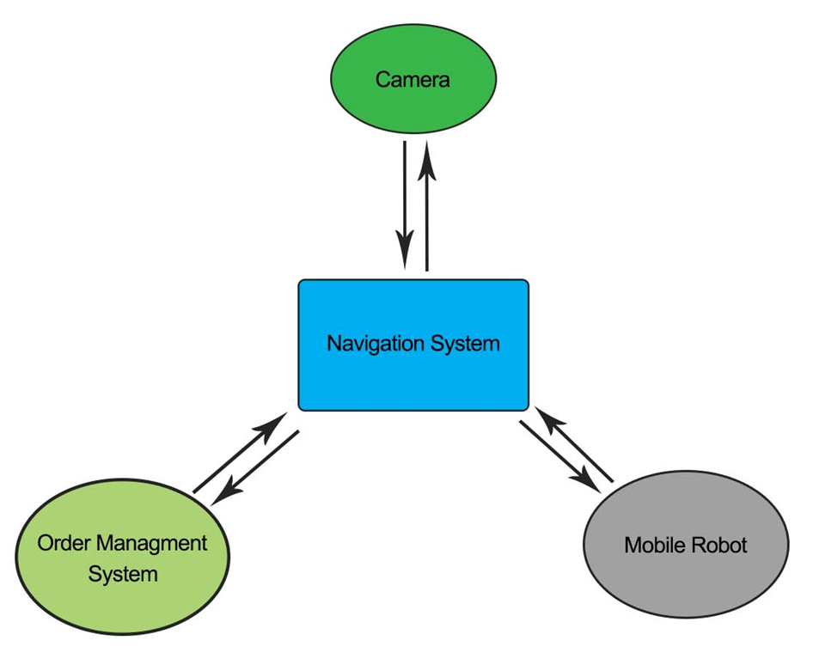


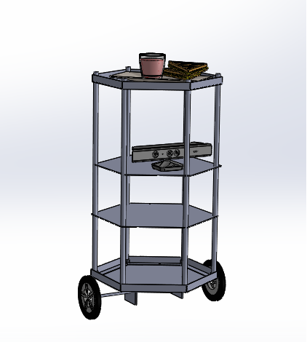
COMMUNICATION BETWEEN SYSTEMS
Communication between systems
Our robot is made up with three different systems,
OMS
Navigation
Robotics hardware
ODBC
WebSocket
Data Explorer
Wi-Fi module

Slide 12
ROBOT DESIGN AND MOTION CONTROL

Slide 13
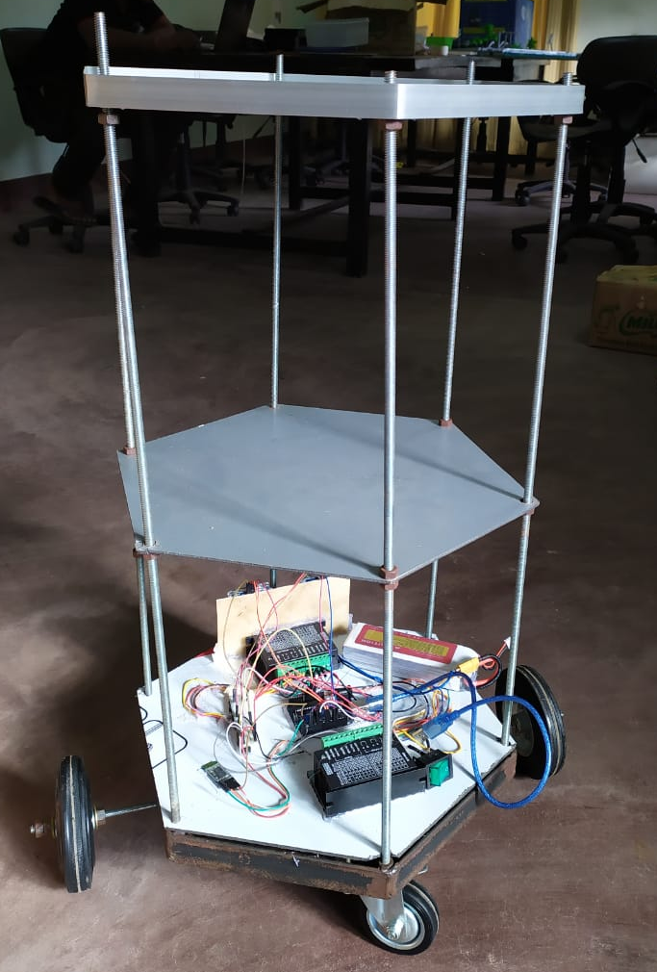
Designing Robot Model

Slide 14
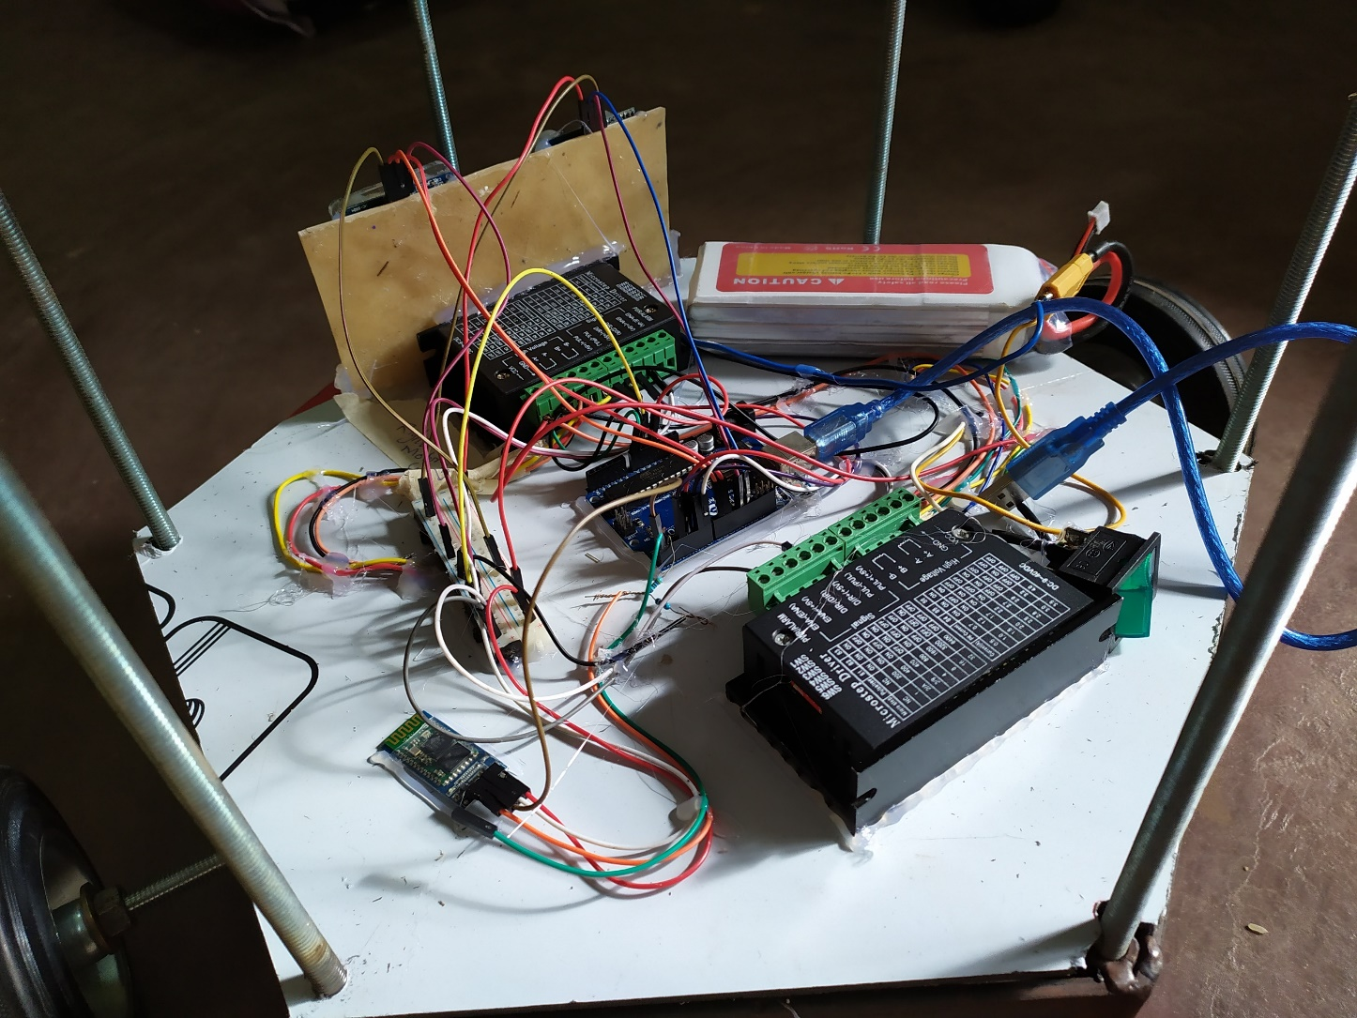
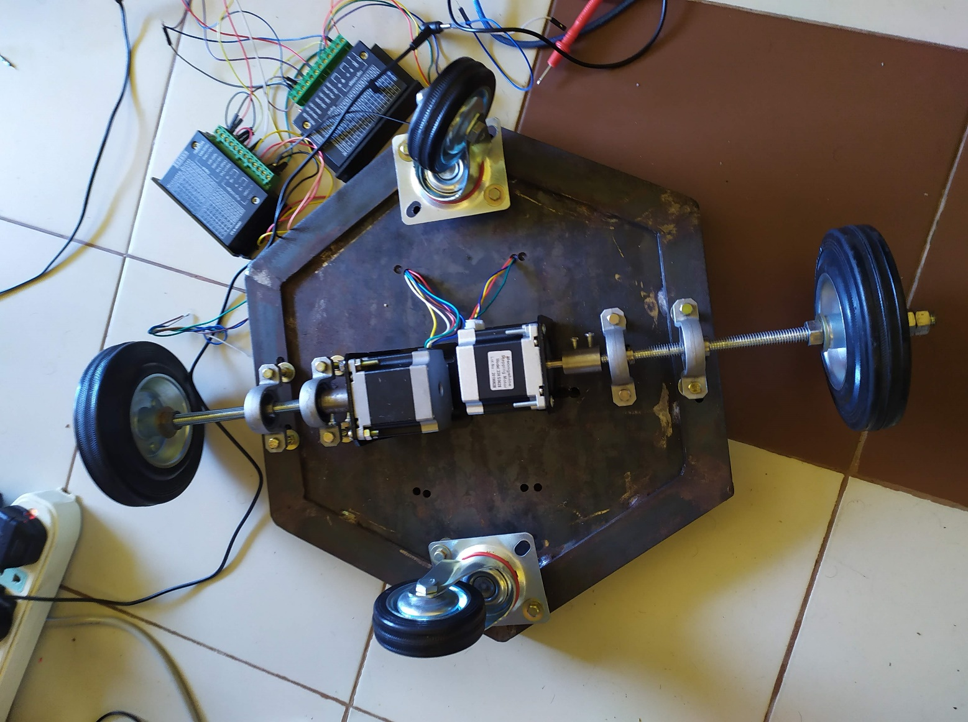
Robot Motor Control and Wheel Alignment

Slide 15
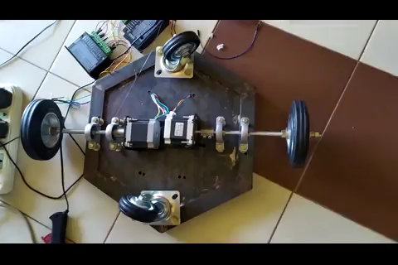

Slide 16
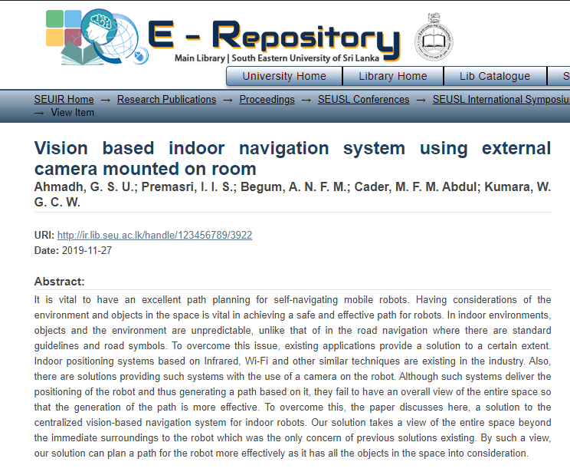
Paper Publication

Slide 17
IMAGE TRANSMISSION, PROCESSING AND PATH PLANNING

Slide 18
Overall system
In this part we will be focusing on camera and the Navigation system.

Slide 19
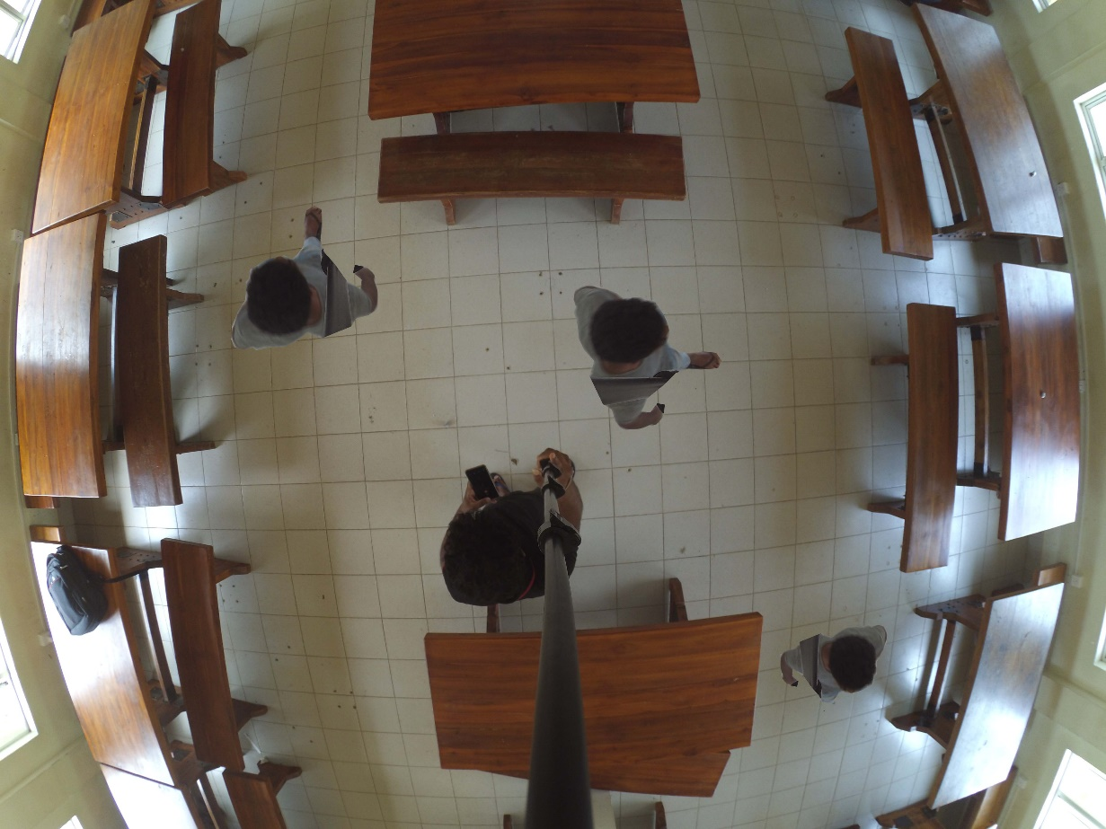
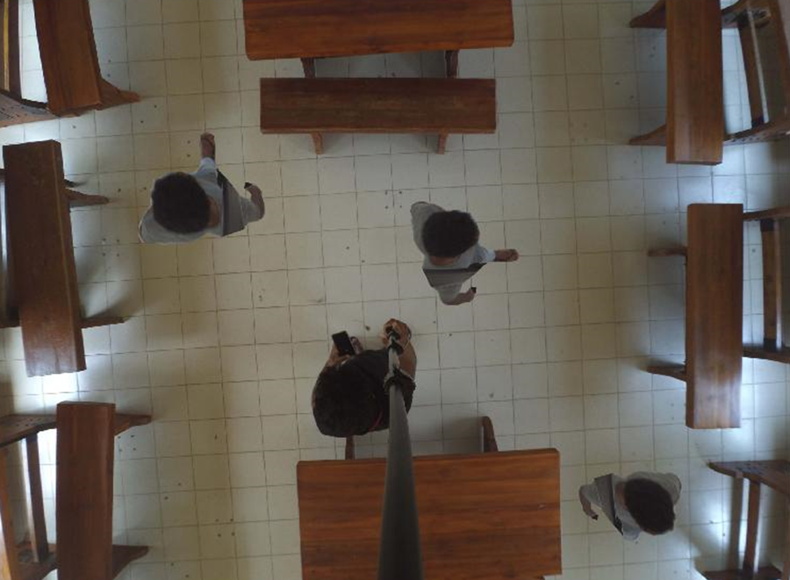
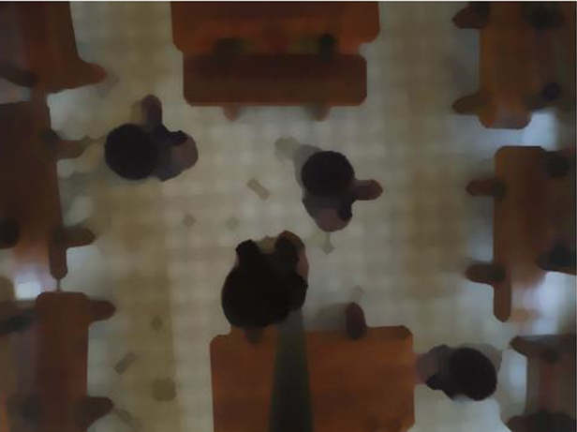
Image Processing
Camera Calibration
Image Erosion and dilation
Removes and adds pixels to the boundaries of objects in an image.
Remove the effects of
lens distortion.

Slide 20
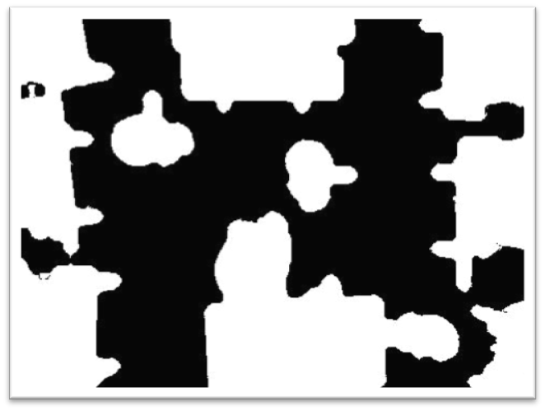
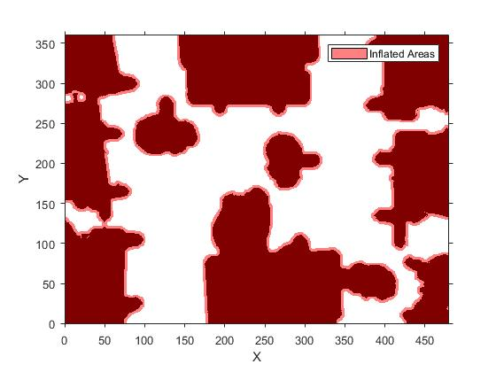
Image Processing
Image Segmentation
Creating Costmap
Partition the image into
multiple segments
Represents planning space for
the path planning algorithm

Slide 21
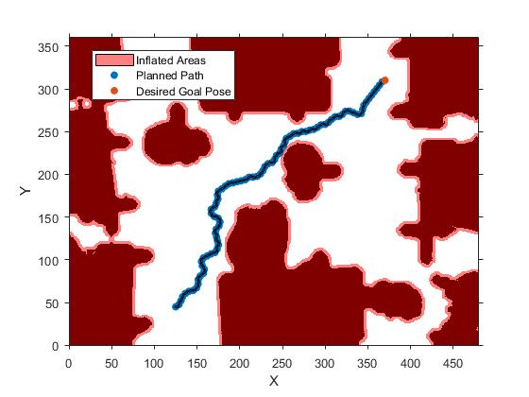
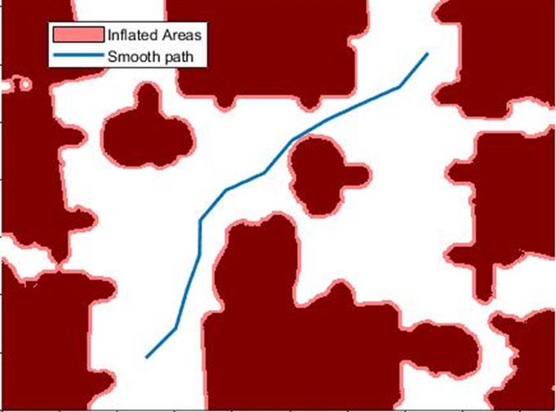
Image Processing
Path Planning with RRT algorithm
Path Optimization

Slide 22
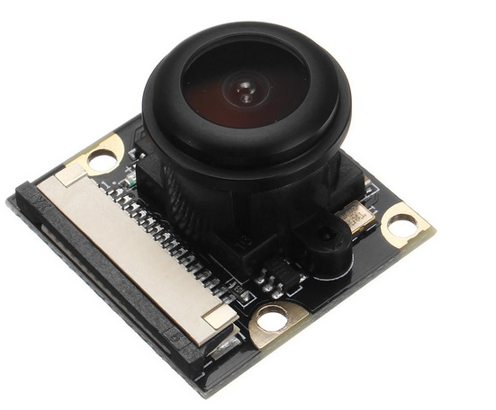
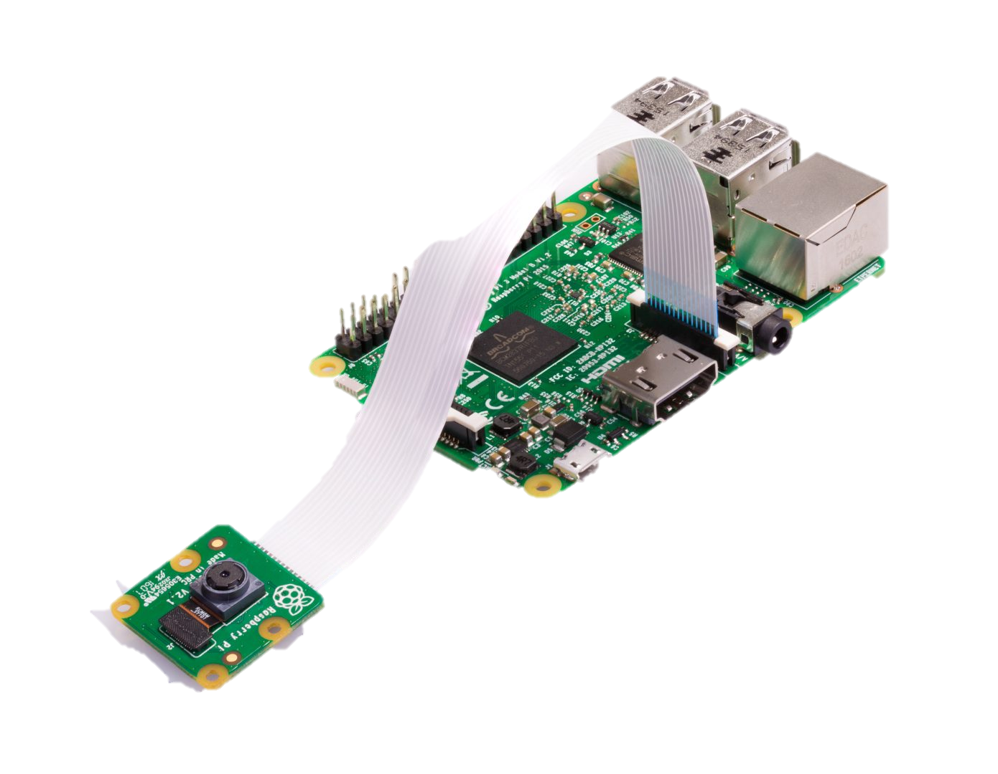
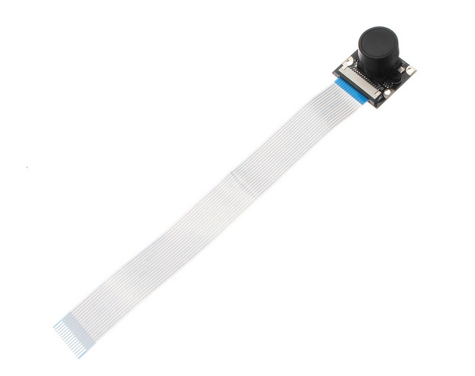
Image Capturing and Transmission
Earlier we were working with saved images to test algorithms.
Now we can process images directly from the camera.
5MP 160° Fish Eye Camera.
Raspberry Pi is working as Webcam Server.
Camera is accessible through WIFI with IP address.

Slide 23
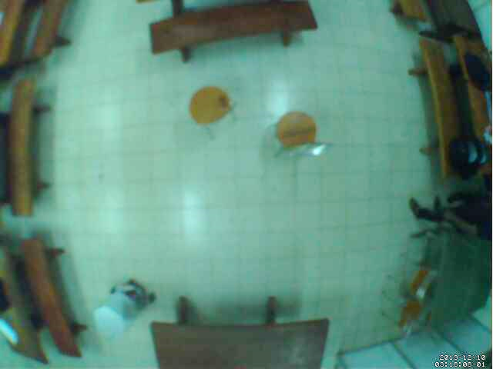
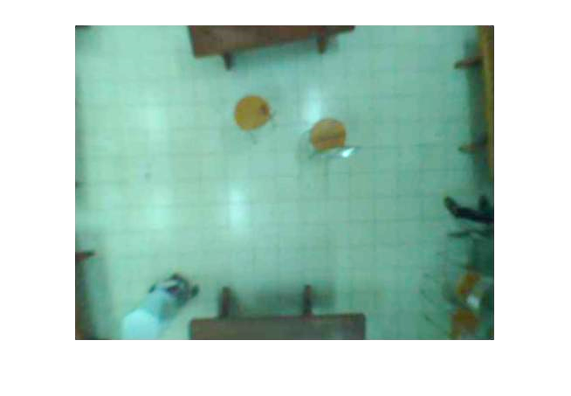
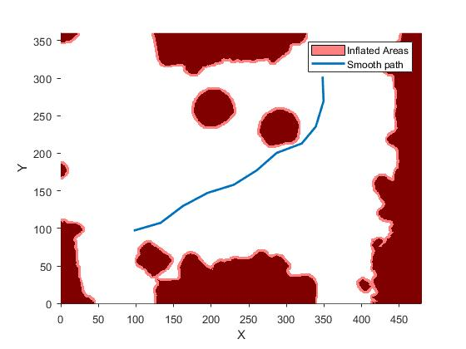
Path Planning on Images from camera
Camera Calibration
Path planning and Optimization

Slide 24
Next steps
As for now, Robot can navigate to its target destination provided that there are no sudden obstacles come on the way.
As an improvement, the robot needs to detect sudden obstacles come on the way and need to follow a new path to reach its destination
To do this, with the help of sensors on the robot body, the obstacles are detected and if the object doesn’t move away from the path for a period of time, then the robot requests the system for a regeneration of path.
A communication from Robot to Matlab will be made to initiate the request and the new path will be sent over the link.

Slide 25
Thank You

